Slide 1

Prof Sam Chan
COMM3131 Online Dating and Hookup Culture
Meeting 4 | “What are you looking for, really?” managing uncertainty online
Notes:
This Photo by Unknown Author is licensed under CC BY

Slide 2
Today
Recap
Uncertainty: What is it and how to reduce it?
Is uncertainty always bad?
Case studies of uncertainty reduction and management in online dating

Slide 3
Recap
Self-disclosure
Self-presentation
From social penetration theory
More a psychological concept
When applied to online dating research: Continuous process
E.g., self-disclosure on Grindr → less loneliness among gay men
From Goffman’s work
More a sociological concept
When applied to online dating research: profiles
E.g., self-presentation (face-pic) depends on cultural and social contexts

Slide 4
Based on social penetration theory, what shall a dating app user do in order to develop intimate relationships with a target?
Notes:
Guerrero, L. K., Andersen, P. A., & Afifi, W. A. (2018). Close encounters: Communication in relationships (5th ed.). Sage.
Benefits of self-disclosure
Self-disclosure conveys trust → develop liking
Self-disclosure leads to reciprocal self-disclosure → develop liking
P.S. Reciprocity: We usually match our self-disclosure level (breath and depth) with other’s self-disclosure level → conversation is based on cooperation → violators are seen rude, cold, unfriendly.

Slide 5
The longer time we chat online, by the time we meet offline, the more we know about each other.
SATISFACTION OFFLINE
TIME ONLINE

Slide 6
Recall the hyperpersonal model? Receivers of CMC will ________ the message sender.
Notes:
Receivers: When receiving messages from others in CMC, an individual may tend to exaggerate perceptions of the message sender. In the absence of the physical and other cues that face-to-face encounters provide, rather than fail to form an impression, receivers fill in the blanks with regard to missing information. This often takes the form of idealization if the initial clues about another person are favorable.

Slide 7
The longer time we chat online, by the time we meet offline, the higher chance we are disappointed (because we overidealize the target)
SATISFACTION OFFLINE
TIME ONLINE

Slide 8
When should we meet offline?
The study of “modality switching”
Measuring amount of time spent online (AMT), sense of intimacy, and perception of the future development of the relationship (POV) (Ramirez et al., 2015)
Notes:
Ramirez, A., Sumner, E. M., Fleuriet, C., & Cole, M. (2015). When online dating partners meet offline: The effect of modality switching on relational communication between online daters. Journal of Computer-Mediated Communication, 20(1), 99-114. https://doi.org/10.1111/jcc4.12101
Respondents recruited for the present study had participated in an online dating site during the previous 3 months and met at least one partner from the site FtF during that period. The final sample of 433 respondents.

Slide 9
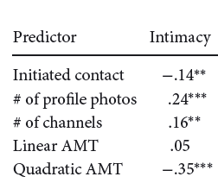
Notes:
AMT spent on online before meeting offline

Slide 10
The perfect moment to switch modality
INTIMACY/ POV OFFLINE
TIME ONLINE
Notes:
17 days - 23 days (3 weeks)

Slide 11

Uncertainty
Inability to predict
  Self-uncertainty
  Partner uncertainty*
  Relationship uncertainty
Notes:
Guerrero, L. K., Andersen, P. A., & Afifi, W. A. (2018). Close encounters: Communication in relationships (5th ed.). Sage.
Inability to predict someone’s attitudes and behaviors
Self-uncertainty (your own feeling … Do you like it not? Do you want it?)
Partner uncertainty (do your date like you?)
Relationship uncertainty (state of the relationship – is this relationship going well? )
Aimei relationship (ambiguous relationship)
Friends → hookup → what we are?

Slide 12
Uncertainty reduction theory (Berger & Calabrese, 1975)
Presence of uncertainty
Desire to reduce uncertainty
Seek more information
Uncertainty reduced
Notes:
Guerrero, L. K., Andersen, P. A., & Afifi, W. A. (2018). Close encounters: Communication in relationships (5th ed.). Sage.
Uncertainty Reduction Theory (Berger & Calabrese, 1975)
Assumption: the driving force in initial encounters is obtaining information about the other person to get to know them better and, ultimately, to reduce uncertainty.
Presence of uncertainty → desire to reduce uncertainty → seek more information (information seeking strategies = uncertainty reduction strategies) → uncertainty reduced

Slide 13

How can you determine if your crush is already in a relationship?
Notes:
This Photo by Unknown Author is licensed under CC BY-ND

Slide 14
Uncertainty reduction strategies
(aka. information seeking strategies)
Passive: unobtrusive observation of the target
Active: (i) manipulation of the social environment,
(ii) asking third parties, or (iii) keep track of conversation record (for CMC)
Interactive: direct contact with the target
Extractive: search of information online (for online)
Notes:
Guerrero, L. K., Andersen, P. A., & Afifi, W. A. (2018). Close encounters: Communication in relationships (5th ed.). Sage.
FOUR General Strategies to Reduce Uncertainty
Passive: People who rely on unobtrusive observation of individuals are using passive strategies (Berger, 1979, 1987).
On social networking sites, this behavior could manifest as looking at the target’s Instagram or Wechat posts (Fox & Anderegg, 2014).
Reading one’s profile
Active: Berger and Calabrese (1975) identified two forms of active uncertainty reduction strategy.
One type involves manipulating the social environment and then observing how someone reacts – throw a party on a weekend to see if they have a plus-one
The second type of active uncertainty reduction strategy involves asking third parties (i.e., friends, family members) about the person in question.
On social networking sites, this strategy takes the form of comparing how targets describe themselves and how their friends talk about them (Ramirez et al., 2002).
On online dating, keep track of conversation record.
Interactive: Interactive strategies involve direct contact between the information seeker and the target.
In an online environment, it could involve commenting on the target’s Facebook posts or asking the target questions (Fox & Anderegg, 2014)
Extractive: unique to the digital environment as it relies on the searchability of the internet. For example, one may perform an online background check on a target or organization (Ramirez et al., 2002).
Doxxing: search for and publish private or identifying information about (a particular individual) on the internet, typically with malicious intent.

Slide 15
Which strategies are less reliable?
Recall warranting, i.e., users will privilege information that is not subject to manipulation

Slide 16
Is uncertainty always bad?
Uncertainty may reduce negative emotions
Uncertainty may produce positive emotions
Notes:
Guerrero, L. K., Andersen, P. A., & Afifi, W. A. (2018). Close encounters: Communication in relationships (5th ed.). Sage.
Is the motivation to reduce uncertainty universal? / Is reduced uncertainty always preferred?
Uncertainty can reduce negative emotions (don’t want to know if your crush as a partner)
There is a chance that the answer is negative
Uncertainty may produce positive emotions (surprise party!)

Slide 17

Uncertainty management theory (Brashers, 2001)
Uncertainty can be appraised as harmful, beneficial, or neutral
Example: HIV/AIDS patients engaged in information avoidance
Desired level of uncertainty
Notes:
Guerrero, L. K., Andersen, P. A., & Afifi, W. A. (2018). Close encounters: Communication in relationships (5th ed.). Sage.
URT is too simplistic.
UMT: uncertainty can be appraised as harmful, beneficial, or neutral depending on the interaction between individual and contextual factors.
E.g., HIV/AIDS patients showed that when uncertainty was perceived as an opportunity, individuals engaged in information avoidance, or in information-seeking behaviors designed to increase their uncertainty levels.
Desired level of uncertainty
Example later

Slide 18
Case studies

Slide 19
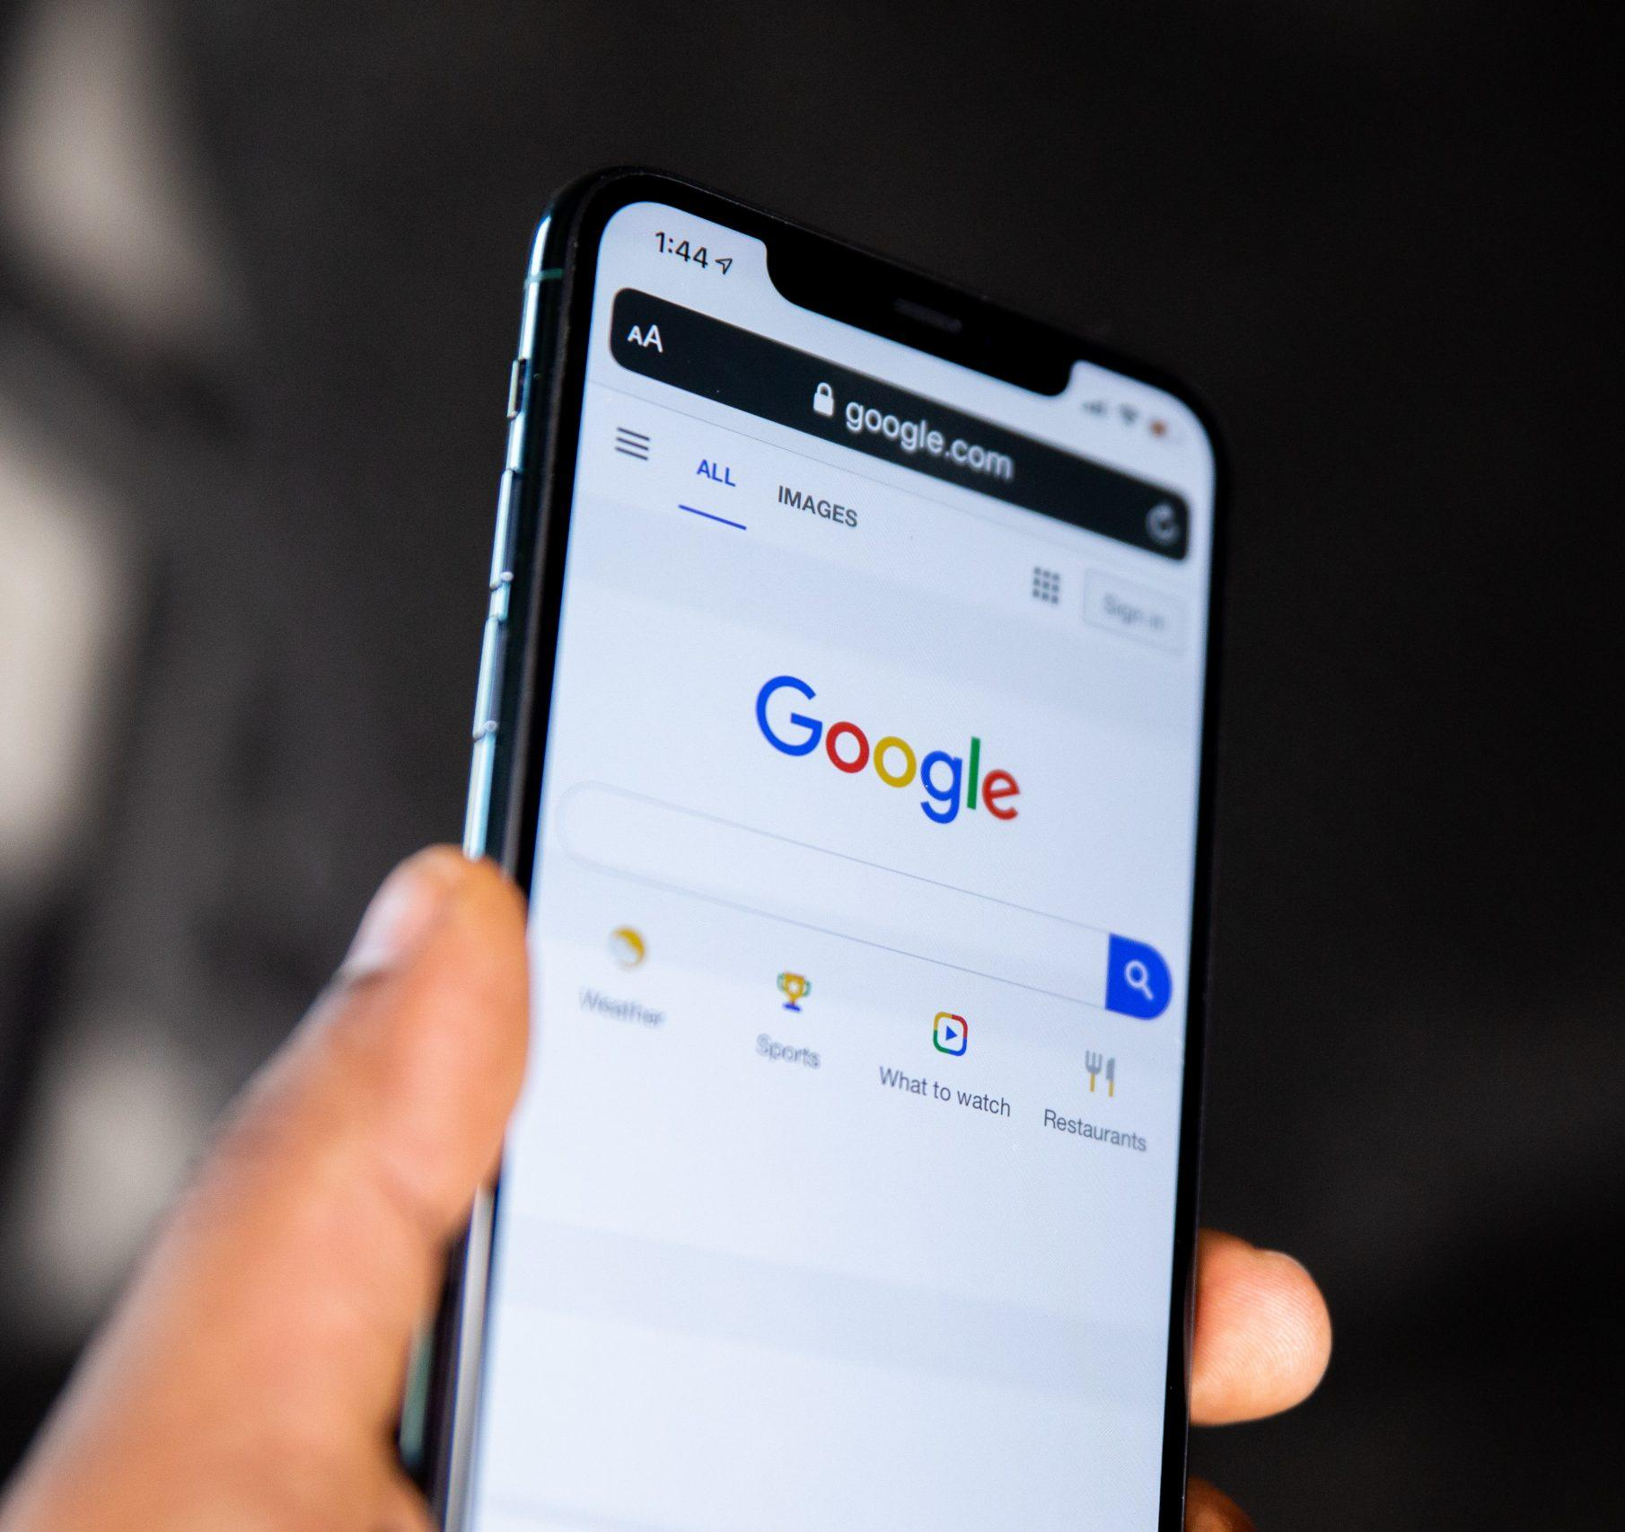
(1) How are privacy concerns related to uncertainty reduction?
Notes:
Image: https://intuji.com/_next/image/?url=https%3A%2F%2Fcms.intuji.com%2Fwp-content%2Fuploads%2F2023%2F02%2Fsolen-feyissa-UWVJaDvXW_c-unsplash-scaled-1.jpg&w=3840&q=75

Slide 20
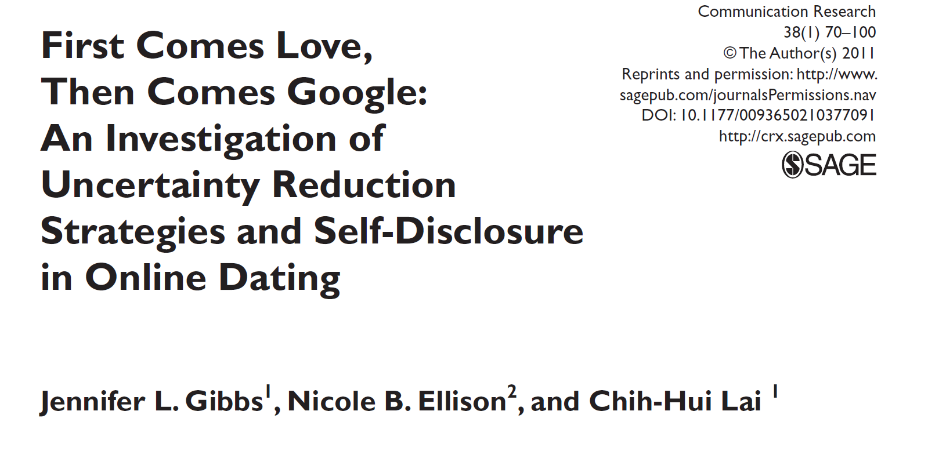
Privacy concerns
  Personal safety
  Misrepresentation
  Recognition
Notes:
Gibbs, J. L., Ellison, N. B., & Lai, C.-H. (2011). First comes love, then comes Google: An investigation of uncertainty reduction strategies and self-disclosure in online dating. Communication Research, 38(1), 70–100. doi:10.1177/0093650210377091
Privacy concerns. Three particular types of concerns
Personal safety: online target may bring me harm
Misrepresentation: online target may deceive me
Recognition: I myself may be recognized by my family members, friends, and work colleagues (hurting social and professional standing)

Slide 21
(a) “‘Googling’ prospective dates (e.g., searching for their name online to verify personal information or find out more about someone’s background)”—extractive;
(b) “saving emails/IM chats to check for consistency”—active;
(c) “comparing photos to written/demographic description in profile”—passive;
(d) “asking follow-up questions in email or IM to see if they are who they say they are”—interactive;
(e) “asking questions on the phone about what they said in a profile, email or IM”— interactive.
  Hypothesis 1:
  Greater privacy concerns →
  ( more / less ) use of uncertainty reduction strategies
  Hypothesis 2:
  Greater use of uncertainty reduction strategies →
  ( more / less ) self-disclosure
Notes:
Gibbs, J. L., Ellison, N. B., & Lai, C.-H. (2011). First comes love, then comes Google: An investigation of uncertainty reduction strategies and self-disclosure in online dating. Communication Research, 38(1), 70–100. doi:10.1177/0093650210377091
H1 Users with greater privacy concerns are more likely to seek information about potential partners, in order to verify that such individuals do not pose a threat to their personal security, that they are representing themselves honestly and accurately, and that they do not represent a risk to one’s social or professional standing
H2 Uncertainty reduction and self-disclosure
With more uncertainty reduction strategies, less uncertainty, thus more interaction

Slide 22
Both hypotheses supported: Privacy concerns → uncertainty reduction strategies → self-disclosure
Open-ended question: Interactive was the most common
Notes:
Gibbs, J. L., Ellison, N. B., & Lai, C.-H. (2011). First comes love, then comes Google: An investigation of uncertainty reduction strategies and self-disclosure in online dating. Communication Research, 38(1), 70–100. doi:10.1177/0093650210377091
Method: 562 respondents, survey
Privacy concern → uncertainty reduction strategies → self-disclosure (amount) All supported
Open-ended: direct questioning: 37%, information-based triangulation: 23% (e.g., cross-referencing and comparing profiles on multiple websites), comparisons: 20%
Interactive is the most common because in CMC there is a lack of traditional identity cues (Tidwell & Walther, 2002)

Slide 23

(2) When uncertainty is desired …
Using Grindr for casual sex or for romance
Notes:
Corriero, E. F., Tong, S. T. (2016). Managing uncertainty in mobile dating applications: Goals, concerns of use, and information seeking in Grindr. Mobile Media & Communication, 4(10), 121–141. doi:10.1177/2050157915614872
Image: https://blog.lighthouse.lgbt/wp-content/uploads/2018/03/phone-addict.jpg

Slide 24
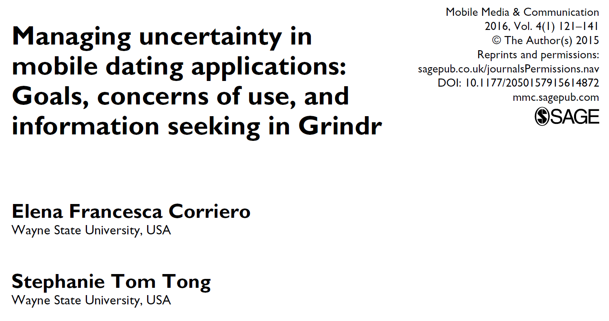
Stronger sexual goals → greater desire for uncertainty
Stronger romantic goals → smaller desire for uncertainty
Greater desire for uncertainty → less information-seeking strategies
(Greater desire for certainty → more information-seeking strategies)
Notes:
URT is too simple; TMIM is too complex
Desired level of uncertainty
Different from Gibbs
The use of Grindr
Users’ goals are diverse;
casual sex, they may want an “impersonal” meeting, “I actually don’t want to know more about you” → uncertainty is a plus (H1 or call it prediction 1)
Romance, they want to know more (H2 or call it prediction 2)
Uncertainty level and information-seeking
Still exist, like in URT

Slide 25
Stronger sexual goals → greater desire for uncertainty (H1)
Stronger romantic goals → smaller desire for uncertainty (H2)
Greater desire for uncertainty → less information-seeking strategies (H4)
Notes:
“I’m not very concerned with being 100% certain about other Grindr users,” “I rarely try to find out things about other users,” and “I don’t have to be completely certain about another Grindr user before meeting him offline” .

Slide 26
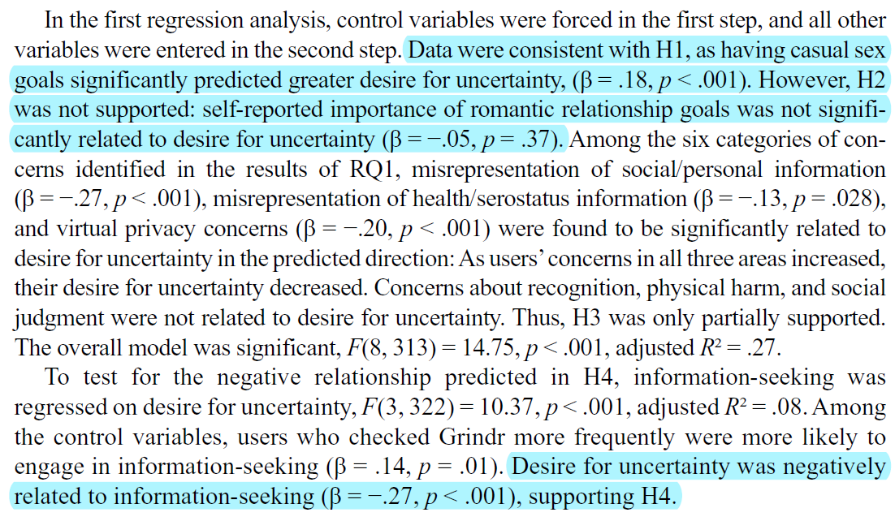
Stronger sexual goals → greater desire for uncertainty (H1)
Stronger romantic goals → smaller desire for uncertainty (H2)
Greater desire for uncertainty → less information-seeking strategies (H4)
Notes:
Method: 326 participants, survey
One is that daters value uncertainty because it allows them to maintain the perception of control over the casual nature of their encounters.
Uncertainty may provide daters with a way to preserve positive illusions about their sexual partners by avoiding additional (and potentially unpleasant) information about them.

Slide 27

Why did romantic goals have no relationship with the desire for uncertainty among gay men using Grindr?
Notes:
This Photo by Unknown Author is licensed under CC BY-SA

Slide 28
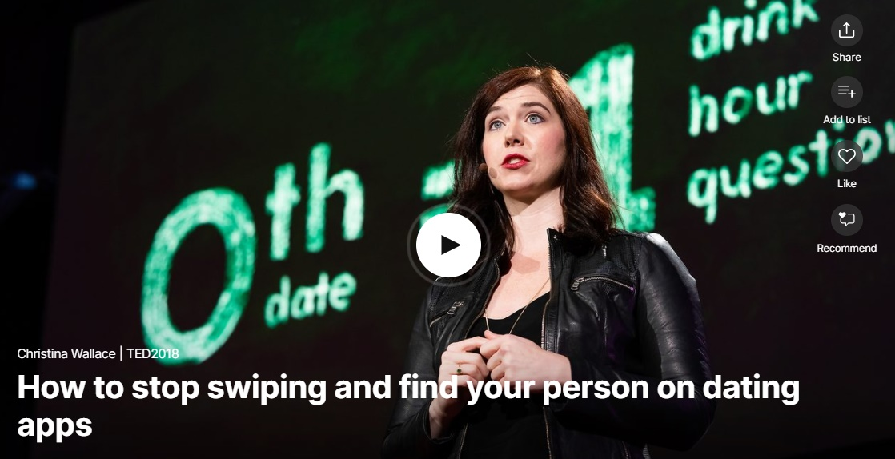
Notes:
https://www.ted.com/talks/christina_wallace_how_to_stop_swiping_and_find_your_person_on_dating_apps?language=zh
TED talk: Christina Wallace: How to Stop Swiping and Find Your Person on Dating Apps (5 mins) – startup entrepreneur in fashion and tech, “44 Female Founders to Know"
What did Christina do to reduce uncertainty?

Slide 29
Discussion:
What did Christina do to reduce uncertainty?

Slide 30
What did Christina do to reduce uncertainty?
Picking OkCupid, instead of Tinder – non-traditional (pre-interactive)
Evaluating the incoming messages – passive
Sending a date invitation and seeing who will accept it – interactive/active
Arrange a short (1 hour) date to explore the target face-to-face – interactive

Slide 31
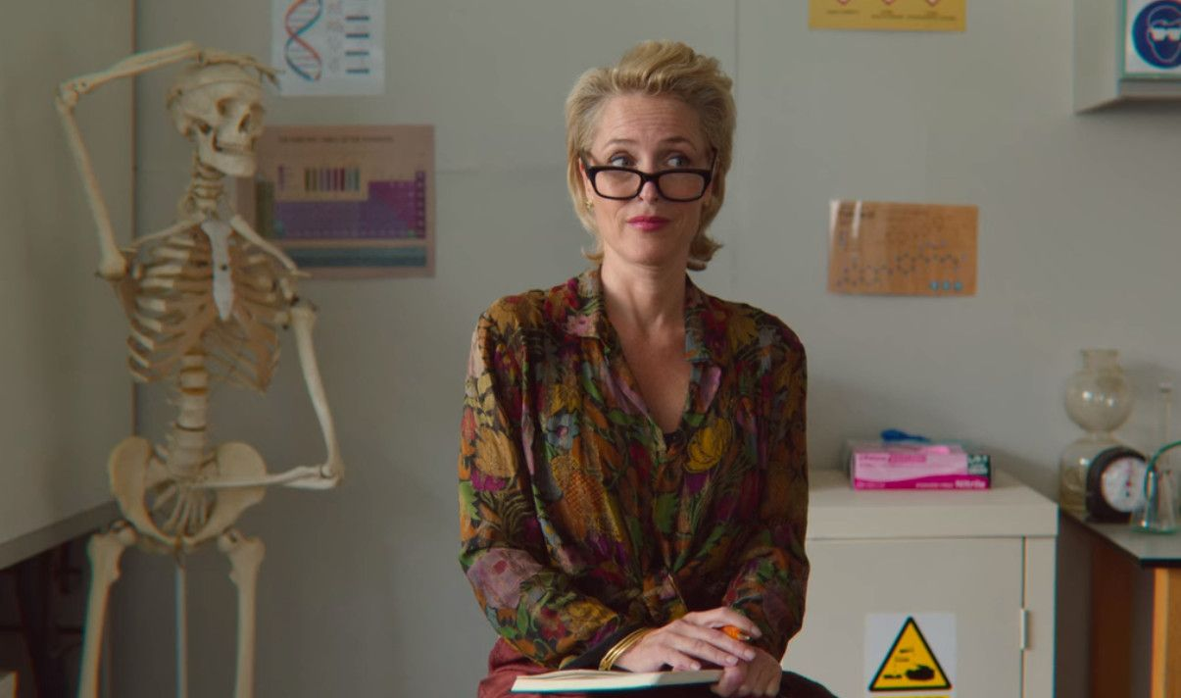
Workshop I:
“Hi, I am your relationship therapist.”

Slide 32
“Hi, I am your relationship therapist.”
Form a group of four students (i.e., six groups in total)
No AI use is allowed
In 60 minutes,
  Analyze the case with computer-mediated communication interpersonal communication theories/concepts (from Meetings 2 to 4)
  Create an 8-minute presentation – give adequate background!
  Submit your group presentation to Blackboard for grading purposes (one person, one submission)

Slide 33
“Hi, I am your relationship therapist.”
Each groups will present their analysis
Members from other groups will ask questions and offer comments

